Slide 1


Department of Computer Science and Engineering
CRYPTOCURRENCY PRICE PREDICTION USING DEEP LEARNING
Team Members Name / Register Number
K SWETHA - 211419104284
S SWETHA - 211419104286
K VIJAYA LAKSHMI - 211419104303
Dr. T. Tamilvizhi M.Tech., PhD.,
Mrs. K. Valarmathi M.E., PhD.,
Guide Name & Designation
Coordinator Name & Designation

Slide 2
Introduction
Cryptocurrency is type of digital asset that relies on a network which is dispersed among numerous systems.
They have ability to exist independently due to their decentralized nature.
Cheaper and quicker money transactions as well as decentralized systems that do not have a single point of failure are two benefits of cryptocurrencies.
Money transfers between two parties without the help of a trustworthy third party, such a bank or credit card company. Investments in cryptocurrencies can be profitable.
Predicting price of a cryptocurrency is difficult because it is quite volatile and prone to market fluctuations.

Slide 3
Objective of the Project
As cryptocurrency is one of the major investments in the world and it takes a lot of labor to predict the future prices by doing the analysis.
Building a deep learning model to forecast the price of cryptocurrency is lot beneficial to the companies and other investors who invest in them and it also reduces the human labor..
The main objective of the proposed system is to increase the accuracy of the price prediction.

Slide 4
Literature Survey
Ref.No. | Year | Title | Methodology | Drawbacks
[1] | 2022 | DL-GuesS: Deep Learning and Sentiment Analysis-Based Cryptocurrency Price Prediction | Sentiment analysis model uses twitter API LSTM and GRU | Same or new approaches can be used to improve accuracy of the system.
[2] | 2021 | Improving the Cryptocurrency Price Prediction Performance Based on Reinforcement Learning | Reinforcement learning | Performance for the prediction of cryptocurrencies should be better for Litecoin and Monero.

Slide 5
Literature Survey
Ref. No. | Year | Title | Methodology | Drawbacks
[3] | 2021 | An On-Chain Analysis-Based Approach to Predict Ethereum Prices | LSTM (on-chain data is used) | In this work only ethereum prices are predicted. It could be used along with off-chain variables (Reddit, twitter) to predict prices.
[4] | 2022 | Sentiment Analysis and Emotion Detection on Cryptocurrency Related Tweets Using Ensemble LSTM-GRU Model | LSTM and GRU | Only sentiment analysis for cryptocurrency is made using tweets. In this work price prediction of cryptocurrency is not implemented.

Slide 6
Problem Statement
People started to invest in cryptocurrency due to high security it has been decentralized, rapid growth in price of a cryptocurrency has it been a limited to certain amount of coin.
Since cryptocurrency market has a lot of fluctuations in their price, it is hard to predict them with high accuracy.
Thus there is a need for highly accurate forecasting models using modern techniques.

Slide 7
Proposed System
Forecast of the cryptocurrency price by their closing price gives more idea to the investors to wait for the closing period to invest if its low than the whole day or to invest on the next day.
We proposed this model to forecast the price of cryptocurrency coins such as Bitcoin, Litecoin, Ethereum and Cardano using Deep Learning with Bidirectional LSTM.
In this model, prediction is made using the historical price datasets and the various performance metrics is evaluated to produce the graph.
To enhance the visualization of graph for our model we have been displayed through a website where one can view the next 15 days prediction graph for each coin.

Slide 8
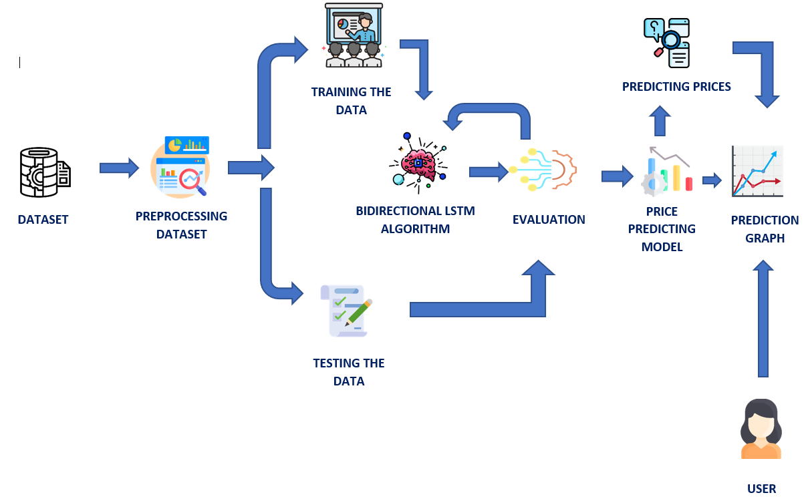
Architecture / Methodology used
The algorithm used to build the model is BiLSTM.
For time-series prediction, it is advantageous since it can learn both forward and backward dependencies.
architecture of the proposed system

Slide 9
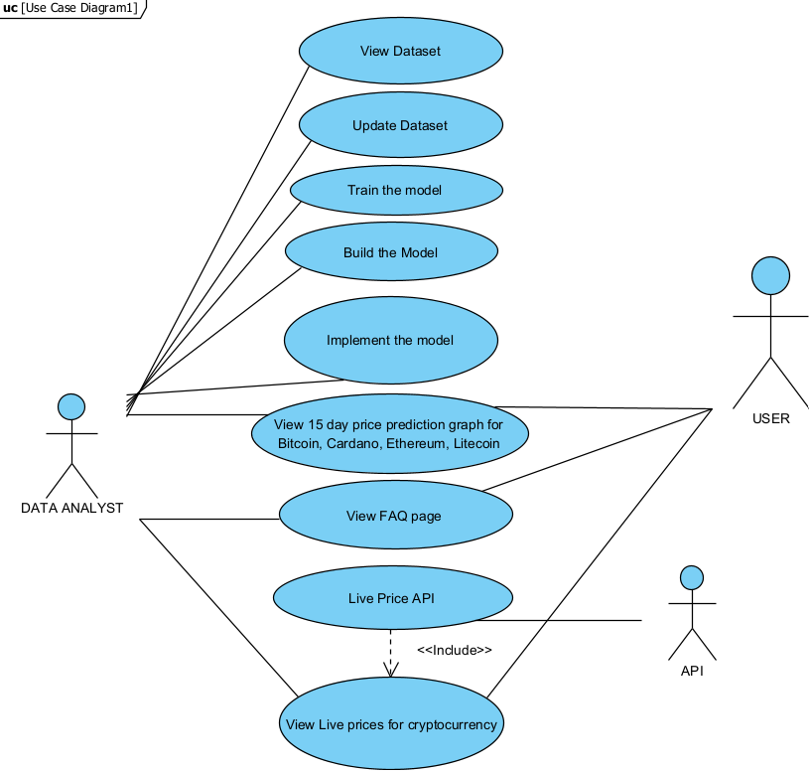
System Design – Use case diagram

Slide 10
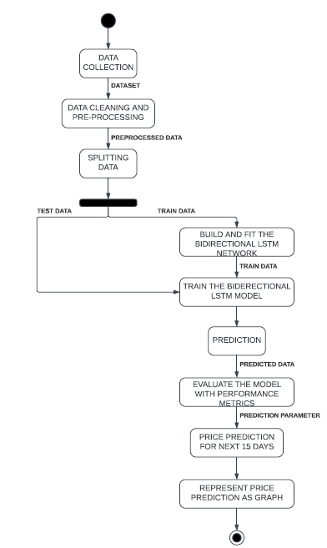
System Design – Activity Diagram

Slide 11
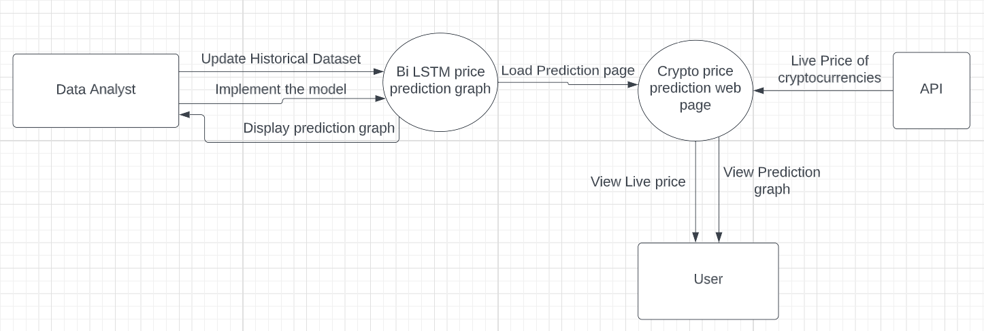
System Design – Data Flow Diagram

Slide 12
Software / Hardware used
Operating System : Windows 10 or later
Tools :
Anaconda with Jupyter Notebook
Python
Visual Studio Code
Hard disk : minimum 80 GB
RAM : minimum 2 GB
Processor: Intel i5

Slide 13
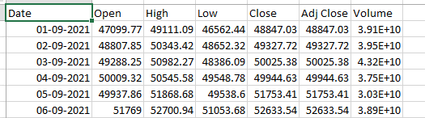
Module Description- Data Processing
The historical price data of the cryptocurrency such as Ethereum, Bitcoin, Litecoin and Cardano is collected from yahoo finance website.
Datasets contain date, open, close, high, low, adjacent close and volume.
Data collected is cleaned by hyper parameter tuning.

Slide 14
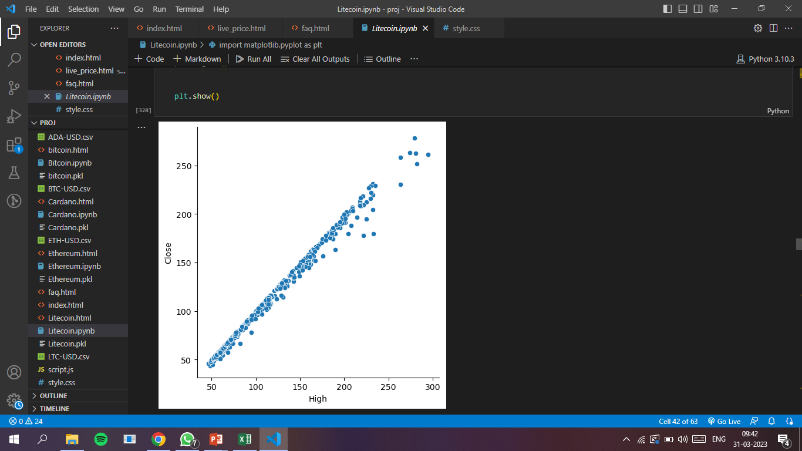
Module Description- Exploratory Data Analysis
The preprocessed data is visualized using seaborn and matplotlib libraries.
This process is to analyze the data for highs and lows in the prices of cryptocurrency.

Slide 15
Module Description- Training The Forecast Model
The algorithm used to train the model is BiLSTM as it offers better prediction.
The analyzed data is split into test and train data.
Since it’s a time series data, sequential model is used and Bidirectional LSTM layer, dropout and dense layers are added to the network.
The model is trained with the train data and accuracy is evaluated using the test data.

Slide 16
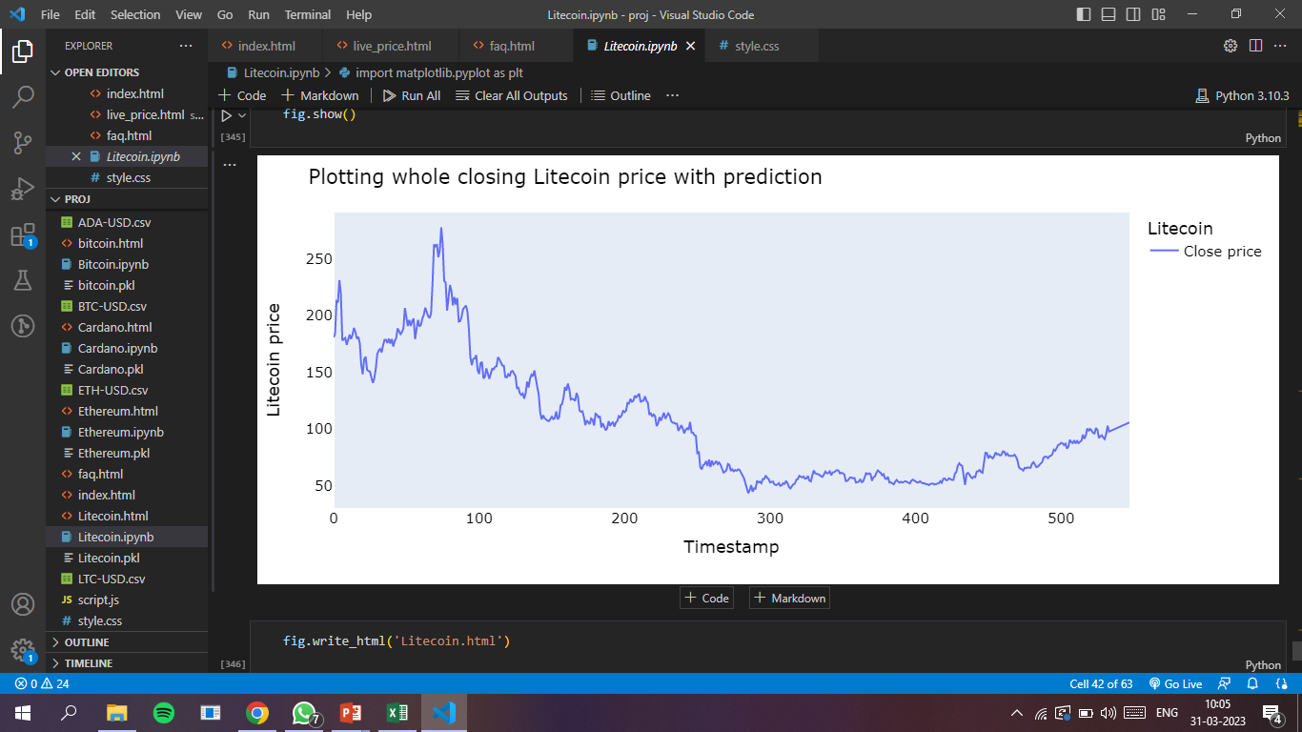
Module Description- Prediction Module
The parameters for the future price prediction is initialized.
Price prediction for the next 15 days is done by the model for each coin.
The predicted price are represented as a graph.

Slide 17
Test Cases & Report
TEST CASE ID | TEST CASE TO BE PERFORMED | EXPECTED RESULT | ACTUAL RESULT | PASS / FAIL
1. | Display of home page | Display of home page | Shows home page with active nav bar | Pass
2. | View of Prediction cards in prediction page | Displays the prediction cards for each coin | Display of prediction cards with Predict button | Pass
3. | Clicking on Predict Button for corresponding coin | Display of Prediction graph for the corresponding coin you chose | Shows the prediction graph for next 15 days of the corresponding coin | Pass
4. | Click on Live Price in nav bar | Shows the Live price of cryptocurrency coins | Displays the live price of each cryptocurrency. | Pass

Slide 18
Performance Evaluation
COINS | ACCURACY | MAPE | R2 SCORE | VARIANCE REGRESSION SCORE
BITCOIN | 95.00 | 3.38 | 0.87 | 0.90
CARDANO | 96.30 | 2.73 | 0.93 | 0.93
ETHEREUM | 97.07 | 2.09 | 0.95 | 0.95
LITECOIN | 95.01 | 3.78 | 0.87 | 0.87

Slide 19

Screenshots
HOME PAGE:

Slide 20

Screenshots
PREDICTION PAGE:

Slide 21
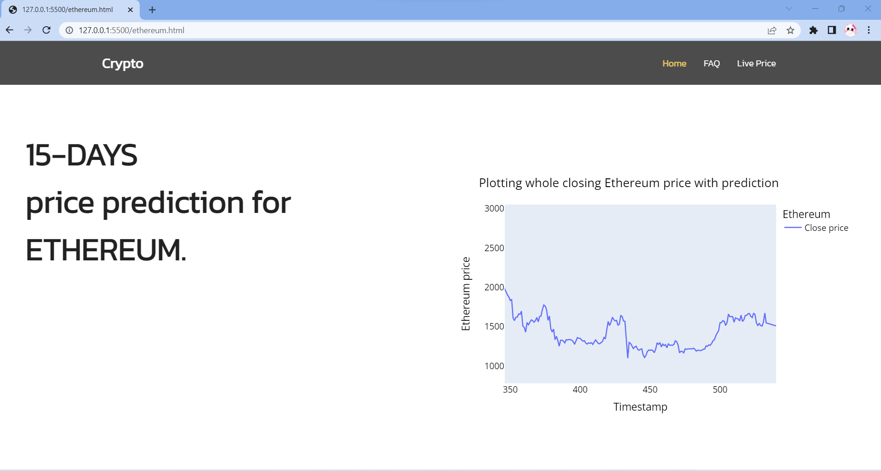
Screenshots
PREDICTION GRAPH FOR ETHEREUM:

Slide 22
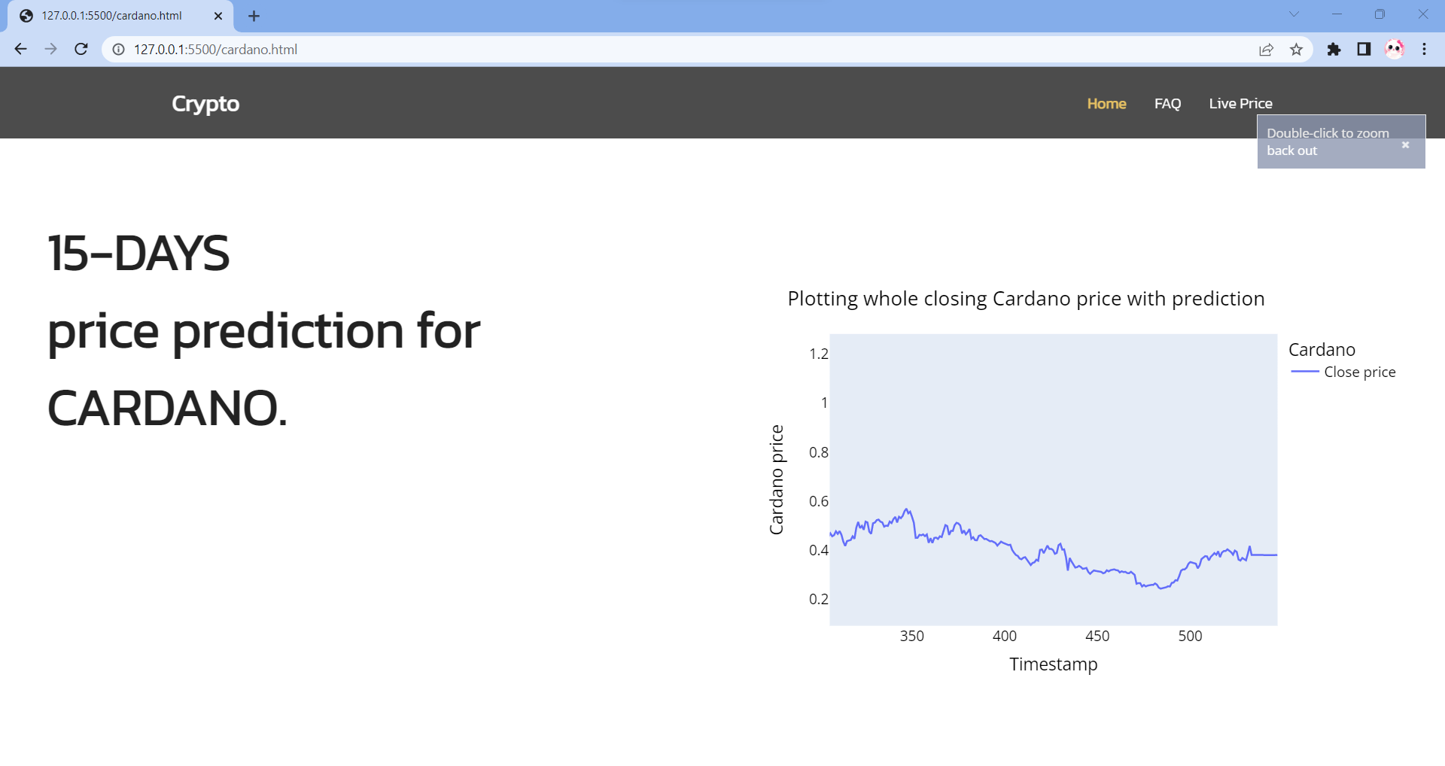
Screenshots
PREDICTION GRAPH FOR CARDANO:

Slide 23
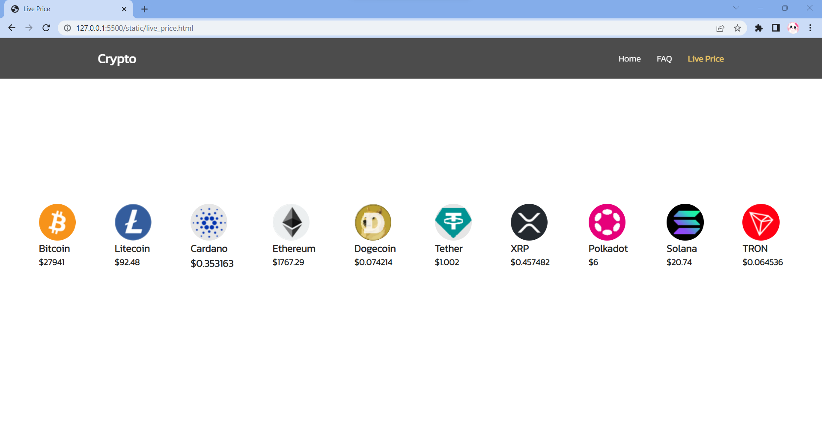
Screenshots
LIVE PRICE PAGE:

Slide 24
Conclusion / Feature Enhancement
Thus this forecasting model predicts prices of cryptocurrency such as Bitcoin, Cardano, Ethereum and Litecoin using BiLSTM algorithm with high accuracy.
The accuracy of the price prediction ranges from 95 to 97 percent.
These prediction are represented as a graph which is embedded in a website.
Thus prediction and live prices can be viewed through the website by the users.
Future enhancement can be made by updating our datasets to ensure our forecast model to be relevant.
So, we can use APIs for data collection or else its better to fetch the live price of the cryptocurrency data from their exchanges.

Slide 25
Reference Paper
[1] R. Parekh et al., "DL-GuesS: Deep Learning and Sentiment Analysis-Based Cryptocurrency Price Prediction," in IEEE Access, vol. 10, pp. 35398-35409, 2022, doi: 10.1109/ACCESS.2022.3163305.
[2] Nishant Jagannath, Tudor Barbulescu, Karam M. Sallam, Ibrahim Elgendi, Braden Megarth, Abbas Jamalipour, Mohamed Abdel-Basset & Kumudu Munasinghe (2021) “An On-Chain Analysis-Based Approach to Predict Ethereum Prices ” IEEE Xplore doi:10.1109/ACCESS.2021.3135620
[3] N. Aslam, F. Rustam, E. Lee, P. B. Washington and I. Ashraf, "Sentiment Analysis and Emotion Detection on Cryptocurrency Related Tweets Using Ensemble LSTM-GRU Model," in IEEE Access, vol. 10, pp. 39313-39324, 2022, doi: 10.1109/ACCESS.2022.3165621.

